Slide 1
DIVAKAR’s PRESENTATION
Conditional Formatting

Slide 2

What is it?
Conditional Formatting in Excel allows you to automatically apply formatting such as colours, icons, or data bars to cells based on the values they contain.

Slide 3
Highlight important data
Identify trends
Why Use it?
Who Can use?
Improve readability and interpretation of data
Automate visual analysis

Slide 4
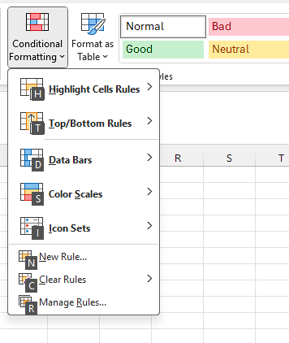
Types Of it!
Highlight Cell Rules
Top/Bottom Rules
Data Bars
Color Scales
Icon Sets

Slide 5
How to Apply ?
Select Range > Home > Conditional Formatting > Choose a rule
Select Range > ALT + H + L > Choose a rule
Examples

Slide 6

CONCLUSION
Conditional Formatting
Makes your data visually insightful.
Easy to highlight key trends.
It saves plenty of time.
It enhance presentations.
Easy to understand by anyone.
It can Highlight Duplicate Quickly.

Slide 7
Thankyou all

